Slide 1
R-trees (Rectangular Tree)
CS163 – Data Structures

Slide 2
Table of contents
01
02
03
04
05
06
Introduction
Description
Demonstration
Definition and history of the r-tree
Structures and algorithms used by the r-tree
Step-by-step demo of the r-tree
Analysis
Applications
Quiz & assignment
Implementation and space-time complexity
What can this data structures be used for?
Get to know the r-tree better

Slide 3
01
Introduction
Definition and history of the r-tree

Slide 4
Introduction
A r-tree allows all points within a given range to be reported efficiently and is typically used in two or higher dimensions.
It is not very different from a traditional balanced tree. In fact, it is often implemented on top of a B+ tree storage layer.
(B+ tree: a variation of the B-tree data structure. In a B+ tree, data pointers are stored only at the leaf nodes of the tree)
Definition
A r-tree is an ordered tree data structure to hold a list of points.
History
The R-tree data structure was first introduced in 1984 by Antonin Guttman, a computer scientist at the University of California, Berkeley.

Slide 5
Properties
- The number of entries of a node (except for the ROOT) in the tree is between m and M/2, where m lies between [0, M/2] (M: the maximum number of entries in a node, yet it may differ for leaf and non-leaf nodes: M = size(Page)/size(Entry))
- Normally, the root has at least 2 entries.
- All leaf nodes are at the same level.
- An R-tree of depth d indexes at least d^{m+1} objects and at most d^{M+1} objects:

Slide 6
Algorithm
1) Let N = root.
2) If N = leaf: return N
If not: Search for the entry in N whose rectangle requires the least area increase to accommodate a new rectangle. In case there are multiple options, we can choose the one with the smallest area.
3) Let N be the child node of the new rectangle and recurse step 2.

Slide 7
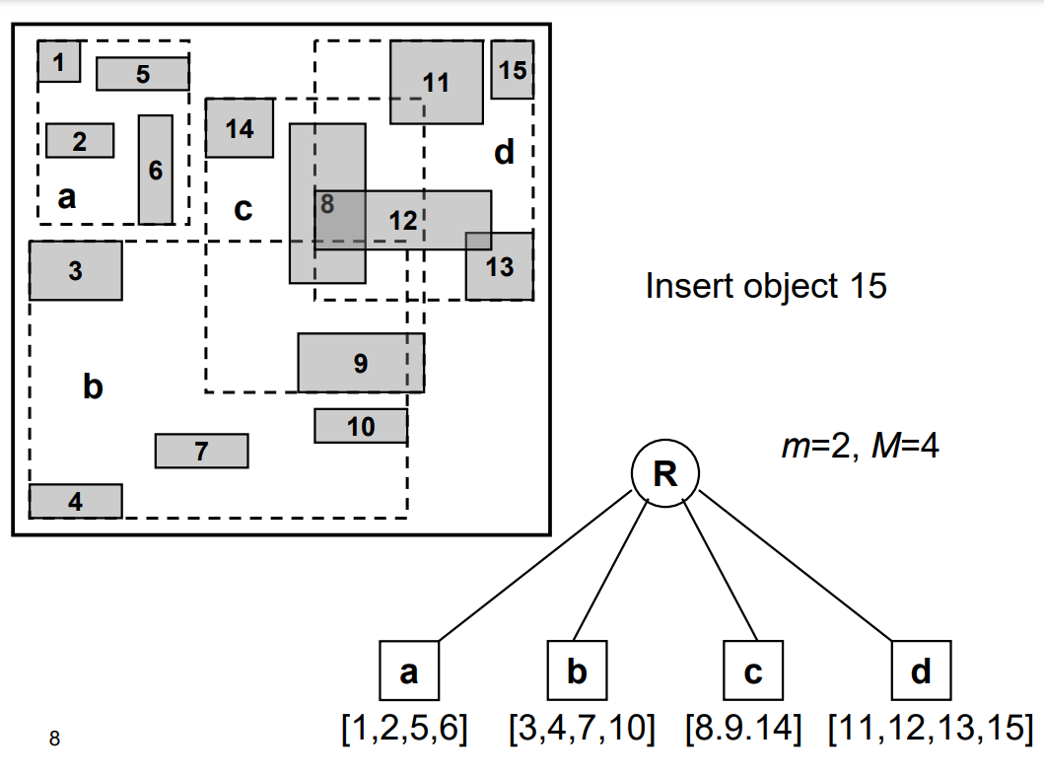
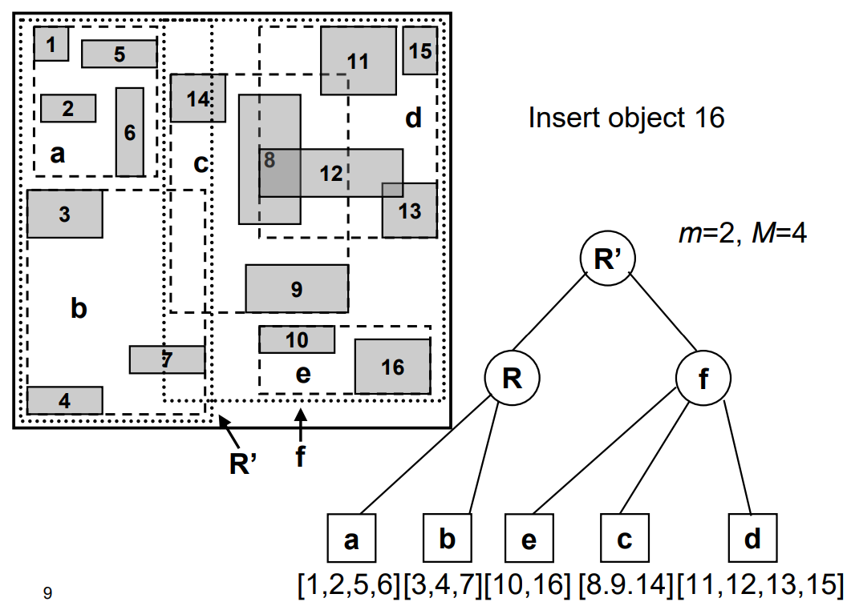

Slide 8
02
Description
Structures and algorithms used by the r-tree

Slide 9
Bounding boxes
Bounding box
Minimum bounding box
A rectangle that contains a group of objects.
The smallest rectangle that contains a group of objects.

Slide 10
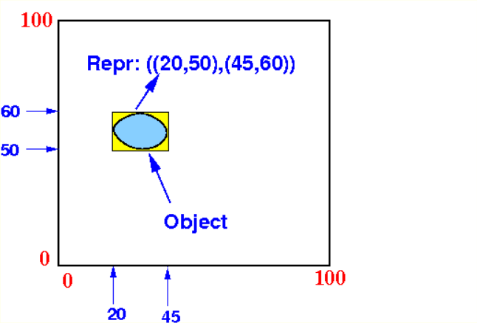
Representing objects
Rectangles
Objects
A rectangle can be defined by the coordinate of its lower left corner and its upper right corner. For example, the representation of the rectangle below is ((10, 20), (50, 40)):
Then, an object can simply be represented by the rectangle that makes up its minimum bounding box.
(10,40)
(50,40)
(10,20)
(50,20)

Slide 11
R-Trees
R-tree is an index tree structure derived from the B-tree that uses bounding boxes as search keys.
BB1
BB2
BB3
BB4
The sub-tree indexed by bounding box BB1 contains only objects that lies inside BB1
The sub-tree indexed by bounding box BB2 contains only objects that lies inside BB2
...

Slide 12
R-Tree index entry
An R-tree index entry contains two things:
(bounding box, child node pointer)
BB1
BB2
BB3
(((10,20),(50,40)), ptr1)
All objects that lie inside ((10,20), (50,40))
The sub-tree indexed by the entry will contain only objects contained within the given bounding box.
It is acceptable for those entry’s bounding boxes to overlap.

Slide 13
R-Tree leaf nodes
Similarly, an R-tree leaf node contains two things:
(minimum bounding box, object pointer)
BB1
BB2
MBB1
(((10,20),(50,40)), obj1)
Minimum bounding box representing area occupied by obj1

Slide 14
Real-life example
In a local map, there are 7 objects: school, POP (point of presence), house1, house2, road1, road2, pipeline
The 3 objects house, road1 and road2 are completely enclosed by the green bounding box ((0,0),(60,50)):
The objects school, POP, house2 and pipeline are completely enclosed by the bounding box ((20,20), (100,80)):
school
POP
house2
road1
house1
pipeline
road2

Slide 15
Resulting R-Tree
((0,0),(60,50))
((20,20),(100,80))
(MBB, house1)
(MBB, road1)
(MBB, school)
(MBB, house2)
(MBB, road2)
(MBB, POP)
(MBB, pipeline)

Slide 16
Resulting R-Tree
Notice that the bounding boxes overlapped:
school
POP
house2
road1
house1
pipeline
road2

Slide 17
Searching a R-tree
Searching an R-tree is like searching a B-tree. Say, we want to search for (40, 75) in the previous map:
school
POP
house2
road1
house1
pipeline
road2

Slide 18
Searching a R-tree
((0,0),(60,50))
((20,20),(100,80))
(40,75) not in here because 75 > 50
20 <= 40 <= 100
20 <= 75 <= 80
(MBB, house1)
(MBB, road1)
(MBB, school)
(MBB, house2)
(MBB, road2)
(MBB, POP)
(MBB, pipeline)
Search all MBBs inside leaf for one that contains (40, 75)
=> school box

Slide 19
Searching a R-tree
Now, let’s search for (55, 35):
school
POP
house2
road1
house1
pipeline
road2

Slide 20
Searching a R-tree
((0,0),(60,50))
((20,20),(100,80))
0 <= 55 <= 60
0 <= 45 <= 50
20 <= 55 <= 100
20 <= 45 <= 80
(MBB, house1)
(MBB, road1)
(MBB, school)
(MBB, house2)
(MBB, road2)
(MBB, POP)
(MBB, pipeline)
Search all MBBs inside leaf for one that contains (55, 45)
=> road2
Search all MBBs inside leaf for one that contains (55, 45)
=> pipeline

Slide 21
Inserting a R-tree
Let’s try inserting the new object X into the tree:
school
POP
house2
road1
x
house1
pipeline
road2

Slide 22
Inserting a R-tree
Since X is in the ((0, 0), (60, 50)) bounding box, we insert X in its subtree:
((0,0),(60,50))
((20,20),(100,80))
(MBB, house1)
(MBB, road1)
(MBB, school)
(MBB, house2)
(MBB, road2)
(MBB, POP)
(MBB, pipeline)

Slide 23
Inserting a R-tree
The leaf node has room, so insert (MBB, x) into the leaf node:
((0,0),(60,50))
((20,20),(100,80))
(MBB, house1)
(MBB, road1)
(MBB, school)
(MBB, house2)
(MBB, road2)
(MBB, x)
(MBB, POP)
(MBB, pipeline)

Slide 24
Inserting a R-tree
But what if X is outside any existing bounding box?
school
POP
x
house2
road1
house1
pipeline
road2

Slide 25
Inserting a R-tree
We enlarge an existing bounding box to accommodate X. For example, we can enlarge ((0,0),(60,50)) to ((0,0),(60,60)):
school
POP
x
house2
road1
house1
pipeline
road2

Slide 26
Inserting a R-tree
Now that there’s a suitable bounding box, we can insert X in as normal:
((0,0),(60,60))
((20,20),(100,80))
(MBB, house1)
(MBB, road1)
(MBB, school)
(MBB, house2)
(MBB, road2)
(MBB, x)
(MBB, POP)
(MBB, pipeline)

Slide 27
Inserting a R-tree
In case a node/leaf is full and cannot add any more items, a split needs to be created just like for B+ trees. However, unlike B+ trees, a split can be made arbitrarily.
Bad split
Good split

Slide 28
Splitting R-tree nodes
Exhaustive algorithm
Quadratic cost algorithm
Split by checking every possible partition.
Time complexity: O(N²)
=> Not feasible for large number of bounding boxes.
Search for pairs of entries that would cause the largest area if placed in the same node. Then put these entries into different nodes.
Consider all remaining entries and consider the one for which the increase in area has the largest possible difference between the two nodes.
This entry is assigned to the node with the smallest increase.
Repeat until all entries are assigned.
Time complexity: O(N²)
=> Better for complex queries involving overlapping regions.

Slide 29
Splitting R-tree nodes
Linear Cost Algorithm
Corner-based Algorithm (New)
Selects two seeds (the first and last entries) and then assigns the remaining entries to the two new nodes based on the minimum increase in the area of the bounding rectangles.
Time complexity: O(N).
=> Relatively simple and efficient, making it suitable for many practical applications.
Selects two "seed" entries that will form the basis of the two new nodes.
Finds the pair of entries that are farthest apart among their corner coordinates. This pair of entries is selected as the seed entries for the two new nodes.
Assign the remaining to the two new nodes based on which seed entry's bounding rectangle the entry is closer to.
Adjust the new bounding rectangles.
Time complexity: O(nlogn)
=> Produces better-quality splits, leading to a more balanced R-tree with smaller bounding rectangles and less overlap.

Slide 30
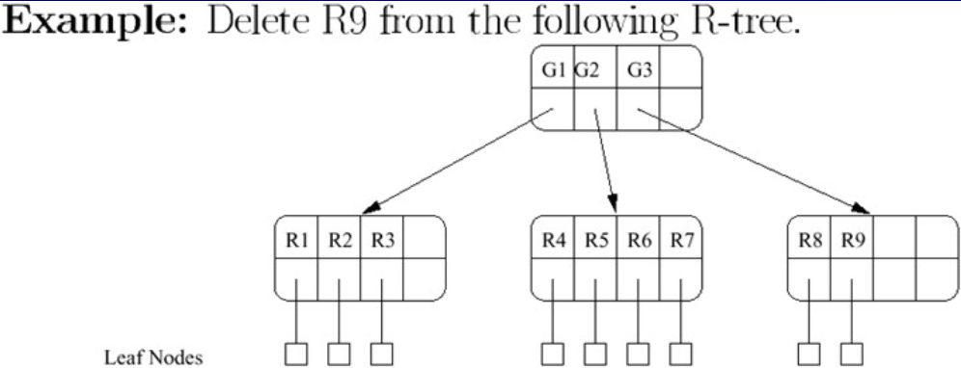
Node Deletion in a R-tree
When we perform deletion of objects from R-tree, it may cause an “underflow” since a R-tree of order K must contain at least (K/2) rectangles (real or group) in it => Ensure the process is not “under-full”.

Slide 31
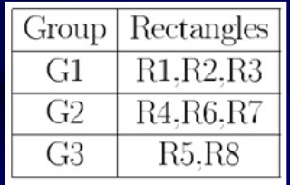
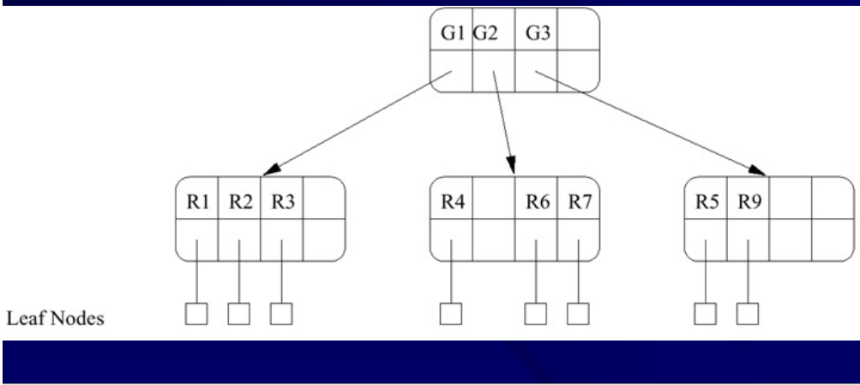

Node Deletion in a R-tree
If we delete R9 immediately, the node containing the rectangle R9 would have only one node in it, which is not optimal space-usage => Create a new logical grouping.
Reallocate group as following
$$\vec{The new r−tree }$$

Slide 32
03
Demonstration
Step-by-step demo of the r-tree

Slide 33
04
Analysis
Implementation and space-time complexity

Slide 34
05
Applications
What can the r-tree be used for?

Slide 35
Applications
Geographic Information Systems
R-trees are widely used in GIS for their ability to facilitate efficient spatial queries, enabling tasks such as route planning and proximity analysis.
Database Systems
Modern databases incorporate R-trees to support spatial data types.
Computer Graphics
R-tree’s ability to quickly identify spatial relationships helps with collision detection, ray tracing and spatial partitioning.

Slide 36
Comparison
 | B+ tree | R-tree
Data Structure | Balanced, stores one-dimensional, ordered data in its leaf nodes. | Hierarchical, stores spatial data objects and their minimum bounding rectangles (MBR)
Query Performance | Highly efficient for one-dimensional queries, such as range queries and point lookups, with strong performance guarantees | Efficient for spatial queries, such as range queries, nearest-neighbor searches, spatial joins
Handling Overlapping Data | Less suitable for handling overlapping data objects | Handle overlapping data objects more effectively
Dynamic Insertion and Deletion | More efficient for updates, as the tree structure can be easily maintained during insertions and deletions | Handle dynamic insertion and deletion of data objects without requiring complete restructuring of the tree

Slide 37
06
Quiz & assignment
Get to know the r-tree better

Slide 38
Question 1
What is the primary purpose of an R-tree data structure?
Indexing and querying one-dimensional, ordered data
Handling dynamic insertion and deletion of data
Indexing and querying spatial data, such as rectangles and polygons
Both B and C
What is the primary purpose of an R-tree data structure?
Indexing and querying one-dimensional, ordered data
Handling dynamic insertion and deletion of data
Indexing and querying spatial data, such as rectangles and polygons
Both B and C

Slide 39
Question 2
Which of the following types of queries are R-trees particularly well-suited for?
Range queries
Nearest-neighbor searches
Spatial joins
All of the above
Which of the following types of queries are R-trees particularly well-suited for?
Range queries
Nearest-neighbor searches
Spatial joins
All of the above

Slide 40
Question 3
Compared to B+ trees, what is a key advantage of R-trees? A. More efficient for one-dimensional, ordered data B. Stronger guarantees for query performance C. Ability to handle variable-sized data objects D. Easier to restructure the tree during updates
Compared to B+ trees, what is a key advantage of R-trees? A. More efficient for one-dimensional, ordered data B. Stronger guarantees for query performance C. Ability to handle variable-sized data objects D. Easier to restructure the tree during updates

Slide 41
Question 4
Which of the following is a characteristic of R-trees that makes them suitable for spatial data? A. Hierarchical representation of data B. Ability to handle overlapping data objects C. Support for multi-dimensional data D. All of the above
Which of the following is a characteristic of R-trees that makes them suitable for spatial data? A. Hierarchical representation of data B. Ability to handle overlapping data objects C. Support for multi-dimensional data D. All of the above

Slide 42
Question 5
When would you choose to use an R-tree over a B+ tree? A. When indexing and querying one-dimensional, ordered data B. When the data is predominantly spatial in nature C. When the data has a fixed size and structure D. When the data is highly dynamic and requires frequent updates
When would you choose to use an R-tree over a B+ tree? A. When indexing and querying one-dimensional, ordered data B. When the data is predominantly spatial in nature C. When the data has a fixed size and structure D. When the data is highly dynamic and requires frequent updates

Slide 43
Problem 1: (Range Query)
Hình chữ nhật là một trong những hình cơ bản của hình học và được nhiều trẻ em yêu thích bởi lẽ việc vẽ nó còn dễ hơn cách mà Lukaku bỏ lỡ cơ hội ghi bàn tại Euro 2024. Để thỏa mãn niềm đam mê vẽ của trẻ mầm non, cô giáo đã tổ chức một cuộc thi vẽ hình chữ nhật.
Trong lớp có một học sinh thiên tài tên là Ronaldo. Với tài năng “vẽ bóng” của mình từ nhỏ, cậu ấy có thể vẽ một lượng lớn hình chữ nhật. Mặc dù số lượng hình chữ nhật là rất lớn, nhưng với tài năng đếm “Quả bóng vàng của Messi” từ khi còn rất nhỏ, cậu ấy vẫn có thể đếm tất cả số lượng hình đã vẽ.
Khi đang vẽ một cách hăng say, Messi đột nhiên đến đưa ra tọa độ của một hình chữ nhật và yêu cầu Ronaldo tìm ra các hình chữ nhật mà giao với hình chữ nhật của Messi cung cấp.

Slide 44
Problem 1: (Range Query)
Yêu cầu bài toán là cho N hình chữ nhật trên hệ tọa độ Oxy và hình chữ nhật truy vấn, tìm và đưa ra danh sách các hình chữ nhật giao với hình chữ nhật đã cho. Số lượng hình chữ nhật có thể lên tới 1000 và tọa độ của nó có thể là số thực.
Example:
Input: Output:
4 Rect(1, 1, 2, 2)
0 0 1 1 Rect(2, 2, 3, 3)
1 1 2 2 Rect(3, 3, 4, 4)
2 2 3 3
3 3 4 4
1.5 1.5 3.5 3.5
(The set of numbers of the rectangle are minX, minY, maxX, maxY respectively. The coordinates are non-negative.)

Slide 45
Problem 1: (Range Query)
Solution:
1. Use the intersects method to check if the query rectangle intersects with the rectangles stored in the R-Tree.
2. Traverse the R-Tree starting from the root node.
3. If a node's bounding box intersects with the query rectangle, recursively search its children.
4. If a leaf node's rectangle intersects with the query rectangle, add it to the result.

Slide 46
vector<Rect> rangeQuery(const RTree& rtree, const Rect& query) {
vector<Rect> results;
queue<Node*> nodes;
nodes.push(rtree.getRoot());
while (!nodes.empty()) {
Node* node = nodes.front();
nodes.pop();
for (const Rect& rect : node->rects) {
if (rect.intersects(query)) {
if (node->isLeaf)
results.push_back(rect);
else {
for (Node* child : node->children) {
if (child->boundingBox.intersects(query))
nodes.push(child);
}
}
}
}
}
return results;
}

Slide 47
Problem 2: (Nearest Neighbor Search)
“Nobita đi mua giúp mẹ 5 cái bánh rán đi con”. Đang mải mê đọc truyện thì Nobita bị mẹ gọi đi mua đồ. Cậu ấy cảm thấy khó chịu nhưng vì nghĩ đến bài kiểm tra 0 điểm giấu ở tủ giày dễ bị phát hiện nên cậu ấy đã nhanh chóng đi mua đồ giúp mẹ và sẵn tiện phi tang luôn chứng cứ.
Khi ra khỏi cửa cậu ấy lại gặp đám Jaian cũng định đi mua bánh rán. Vì bánh rán ở mỗi tiệm là có hạn mà đám của Nobita thì gồm nhiều người nên phải chia ra mua ở nhiều cửa hàng. Số lượng cửa hàng là rất lớn nhưng số lượng bánh rán là có hạn vì thế chúng phải chọn các cửa hàng gần nhà Nobita nhất.
Yêu cầu bài toán là cho N, vị trí của N cửa hàng, M và vị trí nhà của Nobita. Hãy giúp Nobita tìm ra M cửa hàng gần nhà nhất với M là tổng số thành viên của nhóm Nobita.

Slide 48
Problem 2: (Nearest Neighbor Search)
Example:
Input: Output:
5 Rect(2, 3, 3, 4)
1 1 2 2 Rect(4, 1, 5, 2)
2 3 3 4
4 1 5 2
5 5 7 6
7 2 8 3
2
4 3 5 4

Slide 49
Problem 2: (Nearest Neighbor Search)
Solution:
1. Build an R-Tree to store all the rectangles.
2. Use a priority queue to explore nodes in order of their distance to the query rectangle.
3. Start from the root node and push it into the priority queue with a distance of 0.
4. Pop nodes from the queue and examine their children.
5. For leaf nodes, compute the distance to the query and add the nearest rectangles to the result.
6. For internal nodes, compute the distance to their bounding boxes and push them into the queue.

Slide 50
float distance(const Rect& r1, const Rect& r2) {
float dx = std::max({ r1.minX - r2.maxX, r2.minX - r1.maxX, 0.0f });
float dy = std::max({ r1.minY - r2.maxY, r2.minY - r1.maxY, 0.0f });
return dx * dx + dy * dy;
}
vector<Rect> nearestNeighborSearch(const RTree& rtree, const Rect& query, size_t k) {
vector<Rect> results;
priority_queue<NNEntry> pq;
pq.push(NNEntry(rtree.getRoot(), 0));
while (!pq.empty() && results.size() < k) {
NNEntry entry = pq.top();
pq.pop();
if (entry.node->isLeaf)
for (const Rect& rect : entry.node->rects)
if (results.size() < k && rect.intersects(query))
results.push_back(rect);
else
for (size_t i = 0; i < entry.node->children.size(); ++i) {
Node* child = entry.node->children[i];
float dist = distance(query, entry.node->rects[i]);
pq.push(NNEntry(child, dist));
}
}
return results;
}

Slide 51
Problem 3: (Spatial Join)
Tại thành phố APL2024, một công ty từ Thái Lan có tên TALON đang kinh doanh các mặt hàng quái rừng với lợi nhuận rất cao. Với tầm nhìn chiến lược của Oppa, anh sớm đã nhận ra điều này và vì thế anh đã đem công ty GGL qua và mở các cửa hàng cạnh tranh với TALON.
Ban đầu vì chưa nắm rõ thị trường và nơi ẩn thân của các cửa hàng thuộc TALON nên đã khiến GGL bị thua lỗ nghiêm trọng. Bạn hãy giúp Oppa tìm ra các cặp cửa hàng mà GGL cạnh tranh trực tiếp với TALON (giao nhau) để giúp GGL đánh bại TALON nhé.
Yêu cầu bài toán là cho 2 tập hình chữ nhật, tìm các cặp giao nhau.

Slide 52
Problem 3: (Spatial Join)
Example:
Input: Output:
3 A(0, 0, 1, 1)
0 0 1 1 B(0.5, 0.5, 1.5, 1.5)
3 1 4 2
1 5 2 6
3
0.5 0.5 1.5 1.5
5 5 6 6
7 7 8 8

Slide 53
Problem 3: (Spatial Join)
Solution:
1. Build an R-Tree for each dataset.
2. Perform a join by recursively checking pairs of nodes from the two trees.
3. If two internal nodes intersect, recursively check their children.
4. If a leaf node from one tree intersects with a node from the other tree, add the intersecting pairs to the result.

Slide 54
vector<pair<Rect, Rect>> spatialJoin(const RTree& rtreeA, const RTree& rtreeB) {
vector<pair<Rect, Rect>> results;
spatialJoin(rtreeA.getRoot(), rtreeB.getRoot(), results);
return results;
}
void spatialJoin(const Node* nodeA, const Node* nodeB, vector<pair<Rect, Rect>>& results) {
for (const Rect& rectA : nodeA->rects) {
for (const Rect& rectB : nodeB->rects) {
if (rectA.intersects(rectB)) {
if (nodeA->isLeaf && nodeB->isLeaf)
results.push_back({ rectA, rectB });
else if (!nodeA->isLeaf && !nodeB->isLeaf)
for (Node* childA : nodeA->children)
for (Node* childB : nodeB->children)
spatialJoin(childA, childB, results);
else if (!nodeA->isLeaf)
for (Node* childA : nodeA->children)
spatialJoin(childA, nodeB, results);
else
for (Node* childB : nodeB->children)
spatialJoin(nodeA, childB, results);
}
}
}
}

Slide 55
Problem 4: (Spatial Aggregation)
Valorant là một tựa game đang có sức hút cao đối với các game thủ. Người chơi sẽ lựa chọn cho mình một nhân vật để chiến đấu trong một trận. Brimstone là một trong số đó. Với chiêu X là cho nổ ở một phạm vi xác định, anh ấy có thể dễ dàng hạ được toàn bộ team địch vòng một nốt nhạc. Tuy nhiên việc xác định có bao nhiêu kẻ thù trong khu vực chỉ định lại là một việc khó. Hãy giúp Brimstone giải bài toán này nhé.
Yêu cầu bài toán là cho N hình chữ nhật có tọa độ không âm và một vùng cần truy vấn. Hãy xác định xem trong vùng đó có bao nhiêu hình nhữ nhật (tính luôn cả hình chữ nhật có cạnh chung với vùng đã cho).

Slide 56
Problem 4: (Spatial Aggregation)
Example:
Input: Output:
5 2
0 0 1 1
3 1 4 2
1 5 2 6
5 5 6 6
7 7 8 8
0 0 3 3

Slide 57
Problem 3: (Spatial Join)
Solution:
1. Construct an R-Tree structure to manage the spatial objects.
2. Use the R-Tree to find all objects intersecting with the region of interest.
3. Count the number of the spatial objects and return.

Slide 58
int spatialAggregationCount(Node* node, const Rect& query) {
int count = 0;
for (size_t i = 0; i < node->rects.size(); ++i)
if (query.intersects(node->rects[i]))
if (node->isLeaf)
count++;
else
count += spatialAggregationCount(node->children[i], query);
return count;
}
int spatialAggregationCount(const RTree& rtree, const Rect& query) {
return spatialAggregationCount(rtree.getRoot(), query);
}

Slide 59
Thanks!
Do you have any questions?

